Slide 1
Capstone Two - Final Presentation
Title: Predicting Traffic Crashes in Chicago Using Machine Learning
Subtitle: An Analytical Approach to Enhancing Road Safety
Presented by: Angela Mercy Sebasthiyan

Slide 2
Problem statement :
This project aims to predict The most severe traffic crashes in Chicago using inputs such as weather, speed limits, road direction, road conditions, and Traffic way type. The goal is to identify high-risk conditions to develop road safety.
● Context:
Traffic crashes in Chicago affect the safety and the city's regular activities. Predicting severe crashes can help reduce severe accidents.
● Criteria for Success:
Success is measured by the model's accuracy in predicting crash severity and its usefulness in suggesting actionable safety measures.

Slide 3
● Scope of solution space: Develop a linear regression model to predict the “Most Severe Injury” variable and understand key factors contributing to crashes.
● Constraints: Data quality and limitations in capturing all factors affecting crashes. Regulatory and infrastructure constraints may limit actionable recommendations.
● Stakeholders: City Traffic Authorities, Public Safety Officials, Urban Planners, Local Communities
● Data Sources: Traffic crash data from the City of Chicago, including weather and road information

Slide 4
Data Overview
Dataset Source: Chicago Police Department Traffic Crash Dataset
Key Variables:
Target: Most Severe Injury
Features: Days of the week, Months, Posted speed limit, Weather conditions, Road types, etc.
Data Size: 5201 rows, 10 columns

Slide 5
Data Preprocessing
Steps Taken:
Handling Missing Data: Imputed missing values using median/mode.
Data Cleaning: Removed duplicates and irrelevant columns.
Feature Engineering:
One-hot encoding for categorical variables (e.g., weather, road type).
Scaling numerical features (e.g., speed limit).
Result: A clean and structured dataset ready for modeling.

Slide 6
Exploratory Data Analysis (EDA)
Crash Trends:
Crashes peak during certain months and weekdays.
Weather conditions like snow and rain increase crash rates.
Visualization Examples:
Histogram of crash frequency by month.
Higher speed limits correlated with more severe injuries.

Slide 7
Feature Selection
Techniques Used:
Correlation Analysis
Recursive Feature Elimination (RFE)
Feature Importance from Random Forest
Selected Features:
Days of the week
Weather conditions
Speed limits
Road types

Slide 8
Modeling Approach
Algorithms Tested:
Random Forest
Gradient Boosting
Train-Test Split: 80%-20%
Evaluation Metrics:
Accuracy
Precision
Recall
F1 Score
Visualization: Table comparing model performance metrics.

Slide 9
Model Performance - Evaluation Metrics: Comparison Table
Metric | Random Forest (Model 1) | Gradient Boosting (Model 2)
Accuracy | 87.13% | 86.55%
Precision | 76.46 | 78.99%
Recall | 87.13% | 86.55%
F1 Score | 81.44% | 81.81%

Slide 10
Gradient Boosting Model Evaluation
Performance Metrics (GB):
Accuracy: 87.13%
Precision: 76.46%
• Recall: 87.13%
• F1 Score: 81.44%
Key Observations:
Gradient Boosting outperformed other models.
High accuracy in predicting crash occurrences and severity.

Slide 11
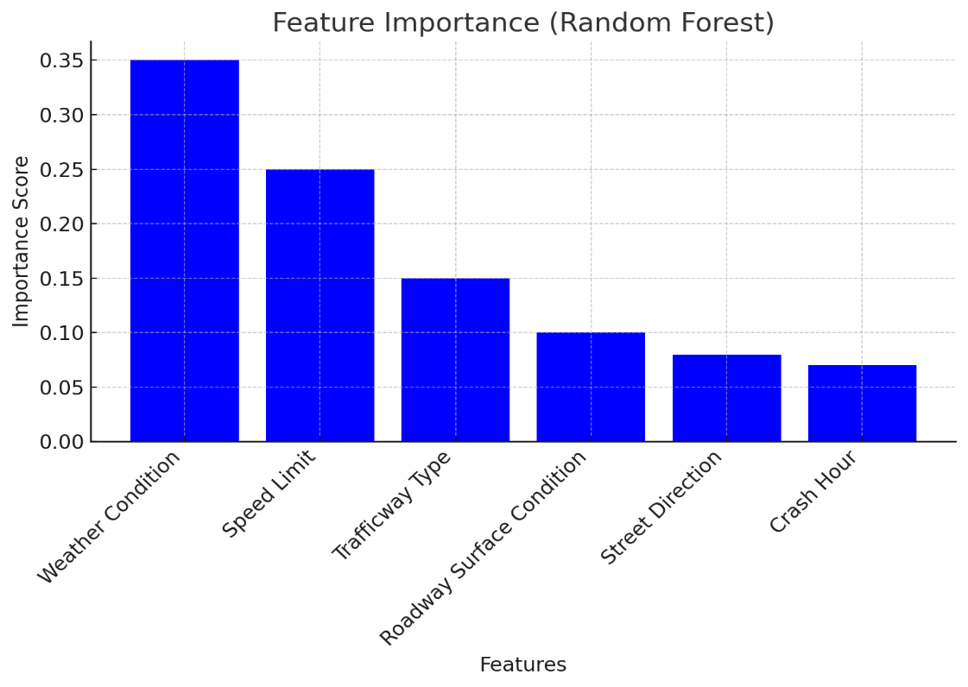

Slide 12
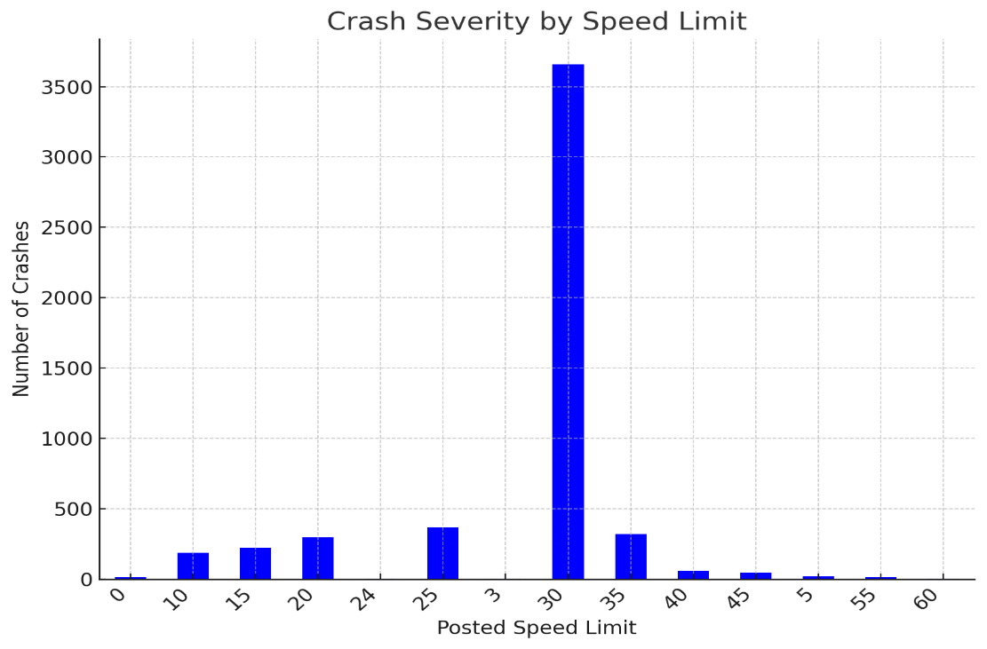

Slide 13
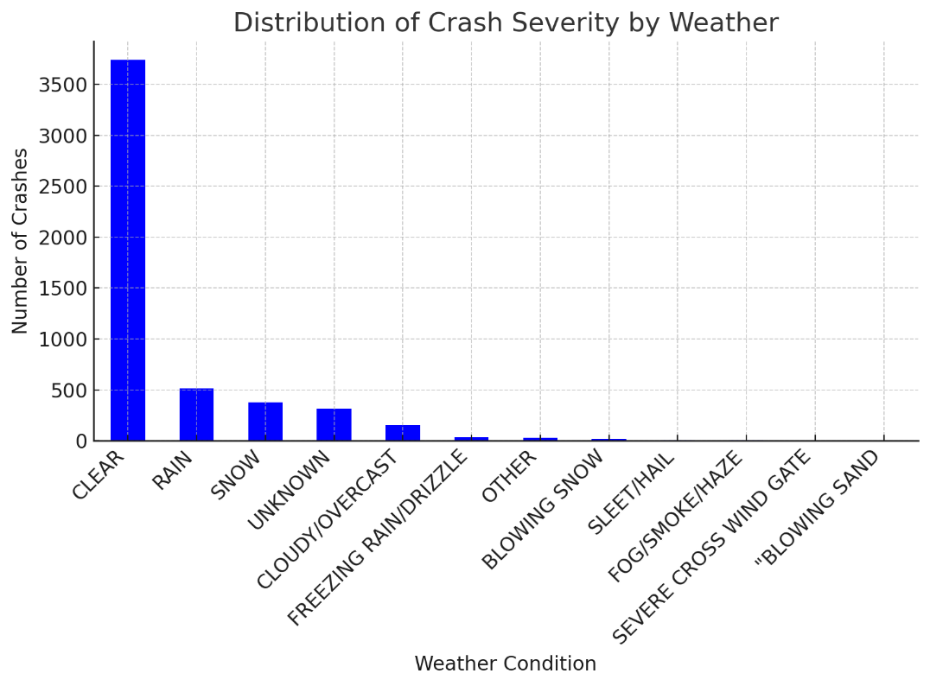

Slide 14
Challenges Faced
Data Imbalance: Fewer severe crashes compared to minor ones.
Data Quality: Missing and inconsistent values in weather and road conditions.
Complexity: High dimensionality in categorical variables.

Slide 15
Conclusion
Summary:
Machine learning models can predict traffic crashes with high accuracy. The Gradient Boosting Accuracy is 87.13%
Recall making it better at identifying all crash severity cases.
Insights from the model can inform safety policies.
Impact: Enhancing road safety and reducing crash-related injuries in Chicago.

